Slide 1
Storm Data Modernization Overview Webinar
Brent MacAloney
Storm Data Program Manager
Performance and Evaluation Branch
Tuesday
June 2nd, 2015

Slide 2
About Today’s Webinar
Everyone except the presenter will be muted
Use the questions feature of the Webinar software to ask questions
I will try my best to answer all questions at the end of the Webinar
Webinar will be recorded and made available on Performance Management website

Slide 3
Topics To Discuss
Storm Data: Where We Are Today
NWS Headquarters Re-organization
Performance and Evaluation Branch
Reinvestment in Storm Data
Storm Data Requirements
Data Entry
Layers to Overlay
Database and Output

Slide 4
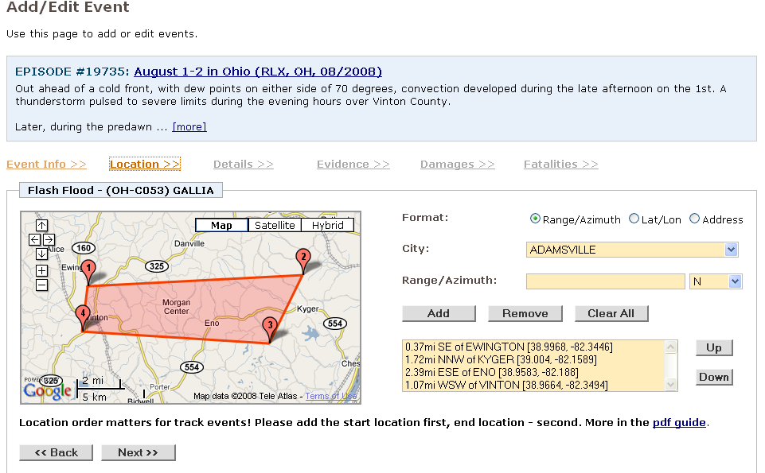
Storm Data: Where We Are Today
Current Version of StormDat
Web-based application
Developed in 2006
Uses Google Maps
Fails to meet needs of Storm Data Focal Points, as well as storm events database users

Slide 5
Current Storm Data Deficiencies
Event Entry (Storm Data Focal Points)
Small mapping interface (429px x 244px)
Lack of county and CWA boundary overlays
Convective events crossing county boundaries must be broken up into county-based segments
Entry of zone-based events is difficult and repetitive
Limited to two points for a storm swath or eight points for a flood area
Inability to import events from DAT program

Slide 6
Current Storm Data Deficiencies
Database (Users of Events Database)
Output is only in CSV format
Difficult to determine when events are updated
Storm tracks are not representative of the area in which the event occurred
NWS constantly changes zone configuration leading to inability to create climatology for zone-based events

Slide 7
NWS Headquarters Re-organization
Re-organization took place on April 1, 2015
Performance Branch is now “Performance and Evaluation Branch”
Work for Office of Chief Operating Officer (COO)
Meeting took place with COO on April 2nd regarding a modernized performance management plan
Updating Storm Data collection is #1 priority
This is the cornerstone to being able to support high-impact verification

Slide 8
Reinvestment in Storm Data
In order to support high-impact verification, management realizes the StormDat program needs to be modernized
Plan is to hire a GIS-experienced developer to overhaul the StormDat program
Development scheduled to begin in Q1-FY16 and take approximately one year

Slide 9
Storm Data Requirements
Requirements have been actively gathered since the last Storm Data Users Meeting in April 2010
Field office visits
Troubleshooting and answering SDFP questions
Talking to external partners
Requirements and specifications document will be written and reviewed in Summer 2015

Slide 10
Data Entry Requirements
High resolution convective weather events
Using entry of events similar to DAT program
Damage/fatality/injury information along track
Width and intensity along track
Photo evidence along track
No need to break events up into county-based segments
Source of estimates for event magnitude

Slide 11
Data Entry Requirements
No need to break up events spanning two or more months.
Events like Drought can be labeled as ongoing
Users will draw impacted area for non-convective events.
No need to break up into zone-based segments
Great for events like winter storm and high wind which impact a large area

Slide 12
Data Entry Requirements
Storm system type for convective events
Pulse, super cell, etc.
Multiple source types
Program currently only allows for the entry of a single source

Slide 13
Data Entry Requirements
Ability to add additional evidence such as radar estimates of EF-scale
Higher resolution lat/lon values
Currently lat/lons limited to two values past the decimal point (e.g., 45.73, -90.23)
Event simplification
High Wind and Strong Winds combined
Remove “Marine” prefix from events over water

Slide 14
Layer Overlay Requirements
Standard GIS layers (e.g., counties, cities, roads)
Tracks from DAT program
Local Storm Reports (LSR)
Radar
Satellite
Rotation Track product
MESH product
Local Spotter Databases

Slide 15
Back End of Database
Microsoft SQL Server 2014
GIS-based entries
KMZ and shapefiles available for download
Ability to output data in legacy format
METADATA added

Slide 16
Additional Requirements
What else are we missing?
How can we better log data to meet your needs and uses?
Email us at: Brent.MacAloney@noaa.gov

